Slide 1

Externalizing & Managing Rules
From Code to Config – Making Rules Maintainable
Presented by: Treveshan Naidoo
TTD Consulting Internal Learning Series
Notes:
Slide Notes: Welcome back to Week 2 of our internal learning series. Today we begin building a basic rule engine framework in code, starting with the structure of individual rules. We'll keep it simple, modular, and extensible.

Slide 2
Welcome
Quick recap of Week 3: execution modes, logs, DI
This week: externalizing rules into config (JSON)
Notes:
Last week we built a solid, traceable, injectable rule engine. Now it’s time to make it scalable. Imagine updating rules without changing code that’s where we’re going today.”

Slide 3
Why Externalize Rules?
Faster changes without redeploying
Make rules editable by analysts/business teams
Store rules in JSON, DB, Excel, or Admin UI’s
Improve visibility and governance
Notes:
Slide Notes: Execution modes give us control over how rules are evaluated.
AllPass is useful when all validations must succeed.
FirstFail is faster when one failure is enough to reject.
Scored is more flexible: maybe 3 out of 5 rules are enough to pass. Explain that these options can be adapted to different business cases.

Slide 4
Common Rule Sources
Source | When to Use
JSON | Lightweight configs or files
Database | For centrally managed rule sets
Excel | When business prefers spreadsheets
Admin UI | Long-term goal for rule control
Notes:
We’re starting with JSON it's dev-friendly and easy to read. Later, we can explore DB-driven rules or even spreadsheet imports if the team needs it.

Slide 5
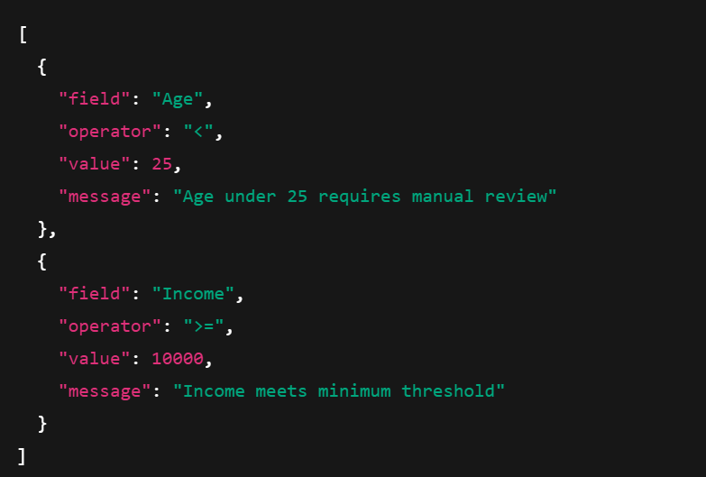
JSON Rule Format (Example)
Notes:
Traceability is critical in regulated environments like insurance. It also helps during debugging. We'll record which rule was run, whether it passed, and what message it produced. These logs help us explain system decisions clearly.

Slide 6
Dynamic Rule Parsing Process
Read JSON config
Deserialize into RuleDefinition objects
Build IRule<T> implementations using reflection or expression trees
Inject or feed them into RuleEngine<T>
Notes:
The loader turns configuration into behavior. This is the key part of abstracting logic from code to config. We'll build a simple class called JsonRuleLoader<T> to do this.

Slide 7
Exercise Instructions
Goal: Convert JSON rules into executable IRule<UnderwritingInput> objects.
Create RuleDefinition class (field, operator, value, message)
Implement JsonRuleLoader<T>
Load sample JSON
Execute rules via RuleEngine<T>
Notes:
This is today’s hands-on goal. You’ll read rules from a file or string, turn them into real logic, and pass them into the engine just like hardcoded rules.

Slide 8
Optional Enhancements
Support AND / OR grouping
Add validation for unknown fields or bad operators
Support custom rule types
Persist rules to a database
Notes:
If you finish early or want to go deeper, try grouping logic or validation. You can even extend this into admin tools later on.

Slide 9
Outcome of This Week
Built support for config-based rules
Parsed and executed JSON-defined rule logic
Reduced reliance on code for logic changes
Opened door for business-owned rules
Notes:
With this foundation, we can plug in UI tools, rule APIs, or even Excel uploads. We’ve moved from a dev-only engine to one that’s configurable and scalable.

Slide 10
Thank You
Congrats on reaching Week 4!
Next step: validation flows, grouping, and maybe score interpretation
Open discussion: how would you use this in your own systems?
Notes:
This was a huge step. Rules are now portable. Think about where else you can use this — approvals, pricing, workflows. Let’s discuss use cases before we wrap

